Slide 1
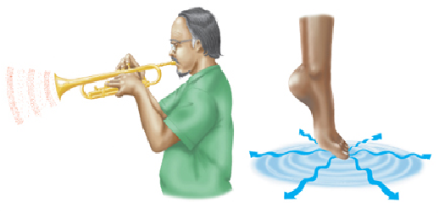
Waves in Matter
Waves are produced by something that vibrates, and they carry energy from one place to another.
Look at the sound wave and the water wave.
Both waves are moving through matter.
What are electromagnetic waves?
Copyright © McGraw-Hill Education

Slide 2
Electromagnetic Waves
Electromagnetic waves are made by vibrating electric charges and can travel through space where matter is not present.
Instead of transferring energy from particle to particle, electromagnetic waves travel by transferring energy between vibrating electric fields and magnetic fields.
What are electromagnetic waves?
Copyright © McGraw-Hill Education

Slide 3
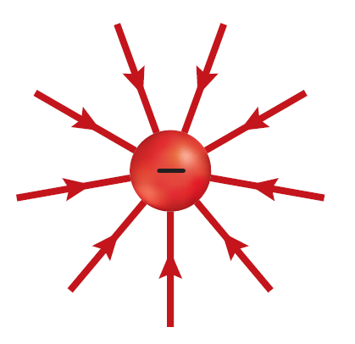
Electric and Magnetic Fields
Electric charges are surrounded by electric fields.
An electric field enables charges to exert forces on each other even when they are far apart.
An electric field exists around an electric charge even if the space around it contains no matter.
What are electromagnetic waves?
Copyright © McGraw-Hill Education

Slide 4
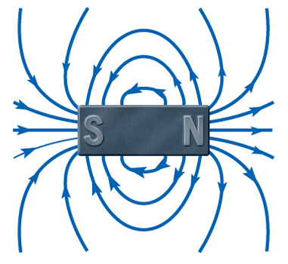
Electric and Magnetic Fields
All magnets are surrounded by a magnetic field.
A magnetic field enables magnets to exert a magnetic force on each other, even when they are far apart.
Magnetic fields exist around magnets even if the space around the magnet contains no matter.
What are electromagnetic waves?
Copyright © McGraw-Hill Education

Slide 5
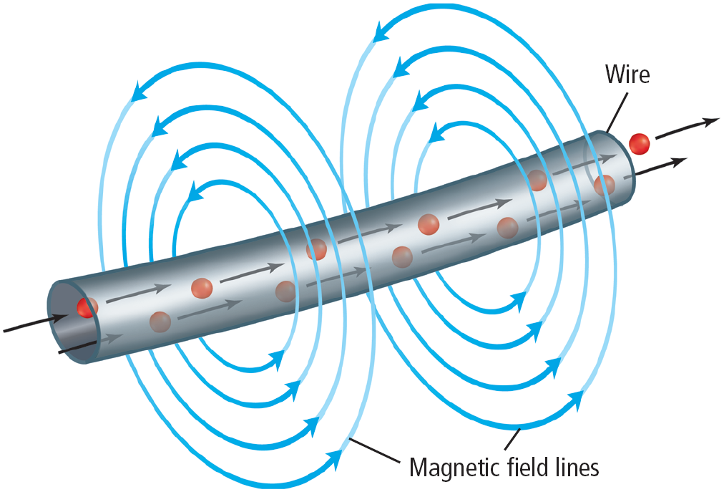
Magnetic Fields and Moving Charges
Moving electric charges are surrounded by magnetic fields.
An electric current flowing through a wire is surrounded by a magnetic field, as shown.
What are electromagnetic waves?
Copyright © McGraw-Hill Education

Slide 6
Changing Electric and Magnetic Fields
A changing magnetic field creates a changing electric field.
The reverse is also true—a changing electric field creates a changing magnetic field.
What are electromagnetic waves?
Copyright © McGraw-Hill Education

Slide 7
Making Electromagnetic Waves
Electromagnetic waves are produced when something vibrates—an electric charge that moves back and forth.
When an electric charge vibrates, the electric field around it changes.
Because the electric charge is in motion, it also has a magnetic field around it.
This magnetic field also changes as the charge vibrates.
As a result, the vibrating electric charge is surrounded by changing electric and magnetic fields.
What are electromagnetic waves?
Copyright © McGraw-Hill Education

Slide 8
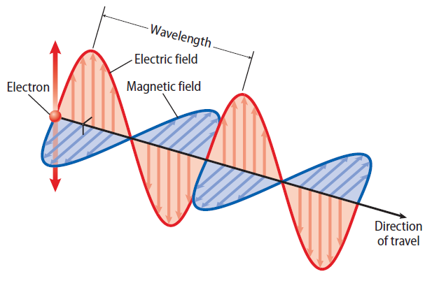
Making Electromagnetic Waves
A vibrating electric charge creates an electromagnetic wave that travels outward in all directions from the charge.
The wave in only one direction is shown here.
Because the electric and magnetic fields vibrate at right angles to the direction the wave travels, an electromagnetic wave is a transverse wave.
What are electromagnetic waves?
Copyright © McGraw-Hill Education

Slide 9
Wave Speed
All electromagnetic waves travel at 300,000 km/s in the vacuum of space.
The speed of electromagnetic waves in space is usually called the “speed of light.”
What are electromagnetic waves?
Copyright © McGraw-Hill Education

Slide 10
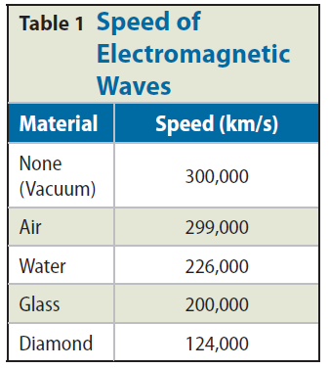
Wave Speed
Nothing travels faster than the speed of light.
In matter, the speed of electromagnetic waves depends on the material they travel through.
What are electromagnetic waves?
Copyright © McGraw-Hill Education

Slide 11
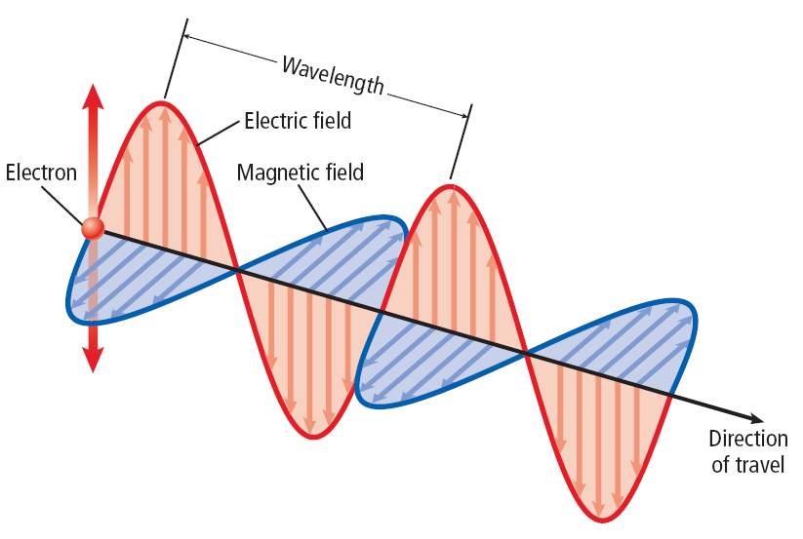
Wavelength and Frequency
The wavelength of an electromagnetic wave is the distance from one crest to another.
The frequency of any wave is the number of wavelengths that pass a point in 1 s.
What are electromagnetic waves?
Copyright © McGraw-Hill Education

Slide 12
Wavelength and Frequency
The frequency of an electromagnetic wave also equals the frequency of the vibrating charge that produces the wave.
This frequency is the number of vibrations, or back and forth movements, of the charge in one second.
As the frequency increases, the wavelength becomes smaller.
What are electromagnetic waves?
Copyright © McGraw-Hill Education

Slide 13
Matter and Electromagnetic Waves
All objects emit electromagnetic waves.
The wavelengths of the emitted waves become shorter as the temperature of the material increases.
As an electromagnetic wave moves, its electric and magnetic fields encounter objects.
These vibrating fields can exert forces on charged particles and magnetic materials, causing them to move.
What are electromagnetic waves?
Copyright © McGraw-Hill Education

Slide 14
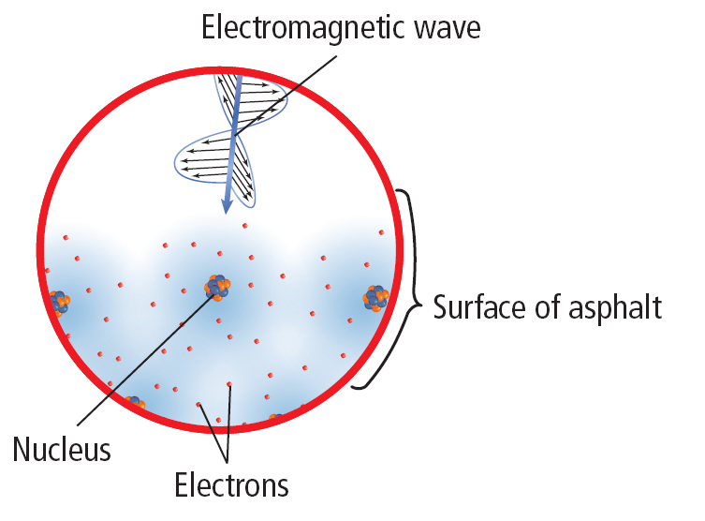
Matter and Electromagnetic Waves
For example, electromagnetic waves from the Sun cause particles in the asphalt to vibrate and gain energy.
The energy carried by an electromagnetic wave is called radiant energy.
What are electromagnetic waves?
Copyright © McGraw-Hill Education

Slide 15
Waves and Particles
The difference between a wave and a particle might seem obvious—a wave is a disturbance that carries energy, and a particle is a piece of matter.
However, in reality the difference is not so clear.
In 1887, Heinrich Hertz found that by shining light on a metal, electrons were ejected from the metal.
Hertz found that whether or not electrons were ejected depended on the frequency of the light and not the amplitude.
What are electromagnetic waves?
Copyright © McGraw-Hill Education

Slide 16
Waves and Particles
Because the energy carried by a wave depends on its amplitude and not its frequency, this result was mysterious.
Years later, Albert Einstein provided an explanation—electromagnetic waves can behave as a particle, called a photon, whose energy depends on the frequency of the waves.
What are electromagnetic waves?
Copyright © McGraw-Hill Education

Slide 17
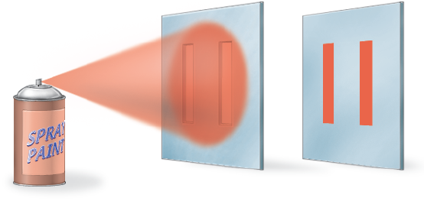
Particles as Waves
Because electromagnetic waves could behave as a particle, others wondered whether matter could behave as a wave.
If a beam of electrons were sprayed at two tiny slits, you might expect that the electrons would strike only the area behind the slits, like the spray paint.
What are electromagnetic waves?
Copyright © McGraw-Hill Education

Slide 18
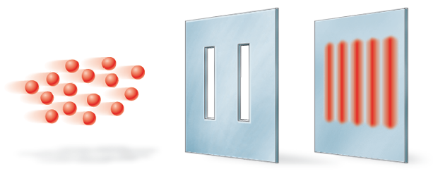
Particles as Waves
Instead, it was found that the electrons formed an interference pattern.
This type of pattern is produced by waves when they pass through two slits and interfere with each other.
What are electromagnetic waves?
Copyright © McGraw-Hill Education

Slide 19
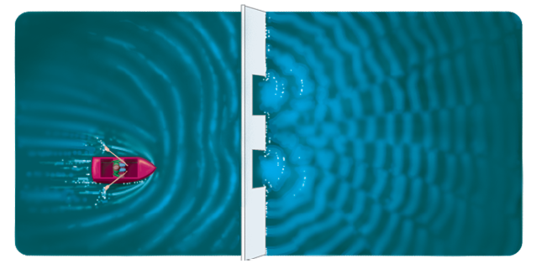
Particles as Waves
Water waves produce an interference pattern after passing through two openings.
It is now known that all particles, not only electrons, can behave like waves.
What are electromagnetic waves?
Copyright © McGraw-Hill Education

